Slide 1
Chapter 2:
Network Protocol Models

Slide 2
Outline
Protocol and Standard
Layered tasks
Internet protocol suites
ISO's OSI model

Slide 3
The Need of Protocols
The scenario: Two people living in two different places want to speak together, what do they need:
Links
Phones
Speak the same langauge
Two computers want to communicate together?

Slide 4
Protocols and Standards
Protocol
A set of rules governing data communications
Syntax: format of data block
Operation: Interaction between senders and recievers
Standards
De facto (in practice) standards
→ not approved but widely adopted
De jure (in law) standards
→ approved by an organization

Slide 5
Standards Organizations
Creation Committees
ISO, ITU-T, ANSI, IEEE, EIA
Forums
Regulatory Agencies

Slide 6
Layered Tasks
Computer networks are complex systems
Tasks involve varieties of hardware and software components, and protocols
Networking task is divided into several subtasks, or layers

Slide 7
Real World Example
Communication between managers of two companies
Communicate

Slide 8
What Actually Happens
Communication takes place thru many layers
Logical communication
Secretary:
reads and reports
the message
Secretary:
types a letter
Delivery boy:
drops the letter
Delivery boy:
takes the letter
Postal truck
Post office:
Processes and routes the letter

Slide 9
Layer Model
Layer N uses services provided by Layer N-1
HOST A
HOST B
Logical
communication path
Layer N
Layer N
Layer N protocol
Using
services
Providing
services
Layer N-1
Layer N-1
Layer N-2
Layer N-2
Virtual Communication System

Slide 10
Why Layers?
Guidelines for protocol developments
Reference model
Modularity
Eases maintenance and updating of systems
A change in one layer is transparent to the rest
Is layering always the best thing to do?
Maybe not ⇨ cross-layer optimization

Slide 11
Internet Layer Model
The Internet Protocol Stack
User
Application Layer
Transport Layer
Network Layer
Data Link Layer
Physical Layer
Software
Hardware
Transmission
Medium

Slide 12


Application Layer
Responsible for providing services to the user
The only layer to interact with user
Data
Logical communication
Data
Application
Layer
SMTP
HTTP
FTP
SMTP
HTTP
FTP
Data
H5
Data
H5
to Transport
from Transport

Slide 13
Transport Layer
Responsible for delivery of a message
from one process to another
Duties/services
Port addressing
Segmentation and reassembly
Connection control
Flow control (end-to-end)
Error control (end-to-end)

Slide 14
Transport Layer
Process
Process
…
Process
Process
…
PORT #
PORT #
Data
Data
Transport
Layer
Data₁
H4
Data₂
H4
Data₃
H4
Data₁
H4
Data₂
H4
Data₃
H4
(segments)
to Network
from Network

Slide 15
Network Layer
Responsible for the delivery of packets
from the original source to the destination
Duties/services
Logical addressing
Routing

Slide 16
Network Layer
from Transport
to Transport
Data
Data
Network
Layer
Data
H3
Data
H3
(packet)
to Data Link
from Data Link

Slide 17

Network Layer
Data
1.1
5.7
1.1, 1.2, 6.1, 5.7, ... are logical addresses
1.1
1.2
Network 1
R1
6.1
Network 6
6.6
6.3
R3
R2
5.2
Router
3.3
Network 5
5.7
Network 3
3.8

Slide 18
Data Link Layer
Responsible for transmitting frames
from one node to the next
Duties/services
Framing
Physical addressing
Flow control (hop-to-hop)
Error control (hop-to-hop)
Access control

Slide 19
Data Link Layer
from Network
to Network
Data
Data
Data Link
Layer
T2
Data
H2
T2
Data
H2
(frame)
to Physical
from Physical

Slide 20
Data Link Layer
A3, 3B, 82, 9F, ... are physical addresses
Data
9F
3B
82
A3
T2
Data
9F
A3
H2

Slide 21
Data Link Layer
Data
1.1
5.7
1.1
1.2
97
32
Network 1
Data
1.1
5.7
97
25
25
R1
6.1
79
Network 6
Data
1.1
5.7
79
62
6.6
6.3
62
12
R3
R2
5.2
54
88
3.3
Data
1.1
5.7
54
74
Network 5
5.7
Network 3
74
3.8

Slide 22
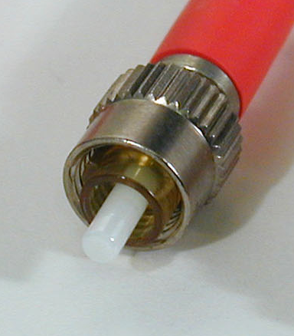
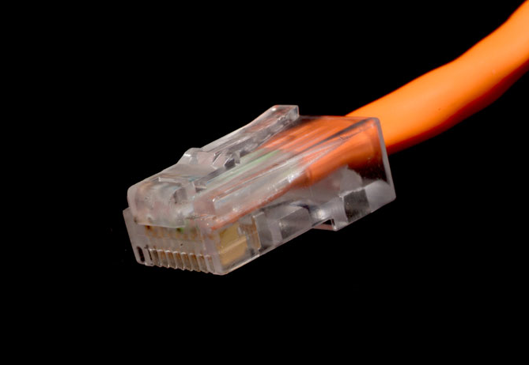
Physical Layer
Responsible for transmitting individual bits
from one node to the next
Duties/services
Physical characteristics of interfaces and media
Representation of bits
Data rate (transmission rate)
Synchronization of bits

Slide 23
Physical Layer
from Data Link
to Data Link
Data
Data
Physical
Layer
01001011
01001011
(bits)
Transmission medium

Slide 24
The Big Picture
5
5
L5 data
H5
L5 data
H5
4
4
L4 data
H4
L4 data
H4
3
3
L3 data
H3
L3 data
H3
2
2
T2
L2 data
H2
T2
L2 data
H2
1
1
0111011010101001010101001
0111010101010010101010101
Transmission medium

Slide 25
Internet Model
sender
router
router
receiver
Application
Transport
Network
Data Link
Physical
Application
Transport
Network
Data Link
Physical
Network
Network
D.L.
D.L.
D.L.
D.L.
P.L.
P.L.
P.L.
P.L.
Transmission medium

Slide 26
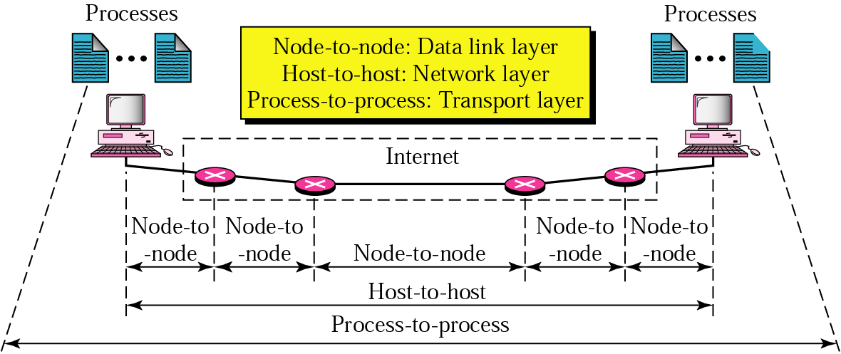
Internet Model

Slide 27
Protocol Suites
A set of protocols must be constructed
to ensure that the resulting communication system is complete and efficient
Each protocol should handle a part of communication not handled by other protocols
How can we guarantee that protocols work well together?
Instead of creating each protocol in isolation, protocols are designed in complete, cooperative sets called suites or families

Slide 28
Internet Protocol Suite
Layer | Protocols
Application | HTTP, FTP, Telnet, SMTP, ...
Transport | TCP, UDP, SCTP, ...
Network | IP (IPv4), IPv6, ICMP, IGMP, ...
Data Link | Ethernet, Wi-Fi, PPP, ...
Physical | RS-232, DSL, 10Base-T, ...

Slide 29
OSI Model
User
OSI – Open Systems Interconnection
Developed by the International Standards Organizations (ISO)
Two additional layers
Presentation layer
Session layer
7.Application Layer
6.Presentation Layer
5.Session Layer
4.Transport Layer
3.Network Layer
2.Data Link Layer
1.Physical Layer
Transmission
Medium

Slide 30
Session Layer
Responsible for establishing, managing and terminating connections between applications
Duties/services
Interaction management
⇨ Simplex, half-duplex, full-duplex
Session recovery

Slide 31
Presentation Layer
Responsible for handling differences in
data representation to applications
Duties/services
Data translation
Encryption
Decryption
Compression

Slide 32














OSI Layers in Real World
7.Manager
Handwrites
a message
Reads the
message
Prepares
final version
Summarizes or
translates letter
6.Assistant
Provides address
and packs letter
Opens letter
5.Secretary
Delivers letter
to post office
Withdraws letter
from mailbox
4.Driver
Checks address
and sorts letter
Checks address
and sorts letter
3.Postal staff
Packs letters
for certain directions
Unpacks
packages
2.Postal staff
Loads on truck
Unloads
from truck
1.Postal staff
transmission medium
Pictures from Wikipedia

